Slide 1
5SENG007W
Software Engineering Principles
and Practice
Week 4 Lecture
Software Development Methodologies

Slide 2
What is a Process … ?
When we provide a service or create a product we always follow a sequence of steps to accomplish a set of tasks
  You do not usually bake a cake before all the ingredients are mixed together
Any process has the following characteristics
  It prescribes all of the major activities
  It uses resources and produces intermediate and final products
  It may include sub-processes and has entry and exit criteria
  The activities are organized in a sequence
  Constrains or control may apply to activities
  (budget control, availability of resources )

Slide 3
Software Processes
Software process involves building of a product - we refer to the process as a life cycle
Software development process – software life cycle
Software Life Cycle
  Specifying,
  Designing,
  Implementing and
  Testing software systems

Slide 4
The Software Process
A structured set of activities required to develop a
software system
  Specification
  Design
  Validation
  Evolution
A software process model is an abstract representation of a process
  It presents a description of a process from some particular perspective

Slide 5
Generic Software Process Models
The waterfall model
  Separate and distinct phases of specification and development
Evolutionary development
  Specification and development are interleaved
Formal systems development
  A mathematical system model is formally transformed to an implementation
Reuse-based development
  The system is assembled from existing components

Slide 6
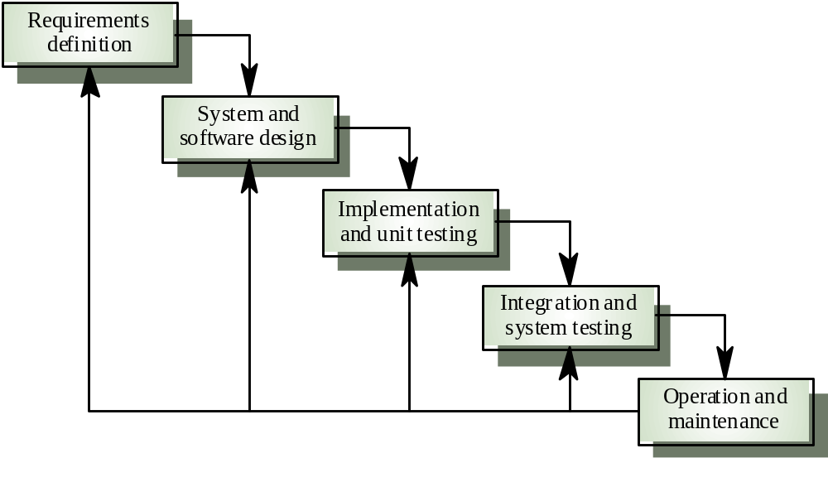
Waterfall Model

Slide 7
Waterfall model phases
Requirements analysis and definition
System and software design
Implementation and unit testing
Integration and system testing
Operation and maintenance
The drawback of the waterfall model is the difficulty of accommodating change after the process is underway

Slide 8
Waterfall model problems
Inflexible partitioning of the project into distinct stages
This makes it difficult to respond to changing customer requirements
Therefore, this model is only appropriate when the requirements are well-understood
Waterfall model describes a process of stepwise refinement
  Based on hardware engineering models
  Widely used in military and aerospace
  industries

Slide 9
Classical Waterfall - restrictions
But software is different :
  No fabrication step
    Program code is another design level
    Hence, no “commit” step – software can always be changed…!
  No body of experience for design analysis (yet)
    Most analysis (testing) is done on program code
    Hence, problems not detected until late in the process
  Waterfall model takes a static view of requirements
    Ignore changing needs
    Lack of user involvement once specification is written
  Unrealistic separation of specification from the design
  Doesn’t accommodate prototyping, reuse, etc

Slide 10
Evolutionary development model
Exploratory development
  Objective is to work with customers and to evolve a final system from an initial outline specification.
  Important – we start with well-understood requirements.
  Allows to develop a system by adding new features as they are proposed by a customer.

Slide 11
Evolutionary Development “Pseudo-Code”
Throw-away prototyping
  Objective is to understand the system requirements. We start with some rough idea of the requirements
    While (adequate system is not developed)
      {
        Develop system (quickly);
        Expose to user comment;
        Refine;
  }
  Particularly suitable where:
    detailed requirements are not possible;
    powerful development tools (e.g GUI) is available

Slide 12
Evolutionary development -restrictions
Problems
  Lack of process visibility
  Systems are often poorly structured
  Special skills (e.g. in languages for rapid prototyping) may be required
Applicability
  For small or medium-size interactive systems
  For parts of large systems (e.g. the user interface)
  For short-lifetime systems

Slide 13
3. Formal systems development
Based on the transformation of a mathematical specification through different representations to an executable program
Transformations are ‘correctness-preserving’ so it is straightforward to show that the program conforms to its specification
Embodied in the ‘Cleanroom’ approach (which was originally developed by IBM) to software development

Slide 14
Formal systems development

Slide 15
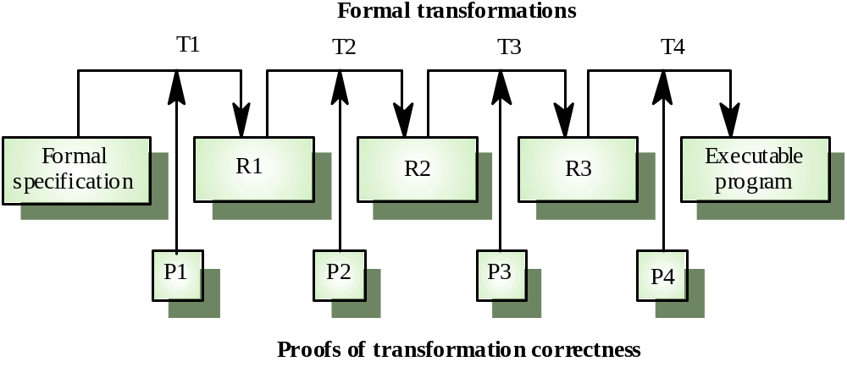
Formal transformations
transformations
proofs
Results/Revisions

Slide 16
Formal transformations
What do we prove:
  Program Terminates (if needed)
  No Deadlock
  Something Good will happen – specify the desired property and prove that the given program will eventually reach the state with this property
  Something Bad will never happen - specify the non desired property and prove that the given program will never be in a state where this property holds (e.g. infinite looping will not occur)
  Prove that the desired invariants of the program are preserved

Slide 17
Formal systems development
Problems
  Need for specialised skills and training to apply the technique
  Difficult to formally specify some aspects of the system such as the user interface
  Specifications are Manual and time consuming
Applicability
  Critical systems especially those where a safety or security case must be made before the system is put into operation

Slide 18
PROBLEM SETUP
Software System
Will failure in
software be
catastrophic
for clients?
for reputation?
for the future
of business?
Anticipated
Behaviour
Are these the
same?
Environment
Real
Behaviour

Slide 19


Formal verification
Checks all possible runs
Advantages:
  Verification of the specification is possible (not only falsification)
Disadvantages
  Hard
  Not always feasible
  Good for control checking (not data)
Notes:
להדגיש שבודקים רק ספספיקציה מסוימת

Slide 20
Model checking
Build a model
A model can be represented as a graph
  Each vertex is a state of the system – value to all the variables (registers)
  Each edge is a valid transition from a state to another state
        Has initial states

Slide 21
Model checking (2)
We can check specifications like:
  Always i<=j
  The program will always end
Notes:
לדבר קצת על סימבולי מול explicit

Slide 22
IDEA OF DEDUCTION
Represent given specification in a way suitable for computation
Distinguish:
What are the
Steps pf the
computation
What is given
initially
What should we
reach
S_i
COND A
true
S_(i+1)
Parameters
B are true

Slide 23
Formal Development is hard and it is introduced in level 6 Formal Methods module for SE students
It gives some heuristics to reason about your code and test it

Slide 24
4. Reuse-oriented development
Based on systematic reuse where systems are integrated from existing components or COTS (Commercial-off-the-shelf) systems
Process stages
  Component analysis
  Requirements modification
  System design with reuse
  Development and integration
This approach is becoming more important

Slide 25
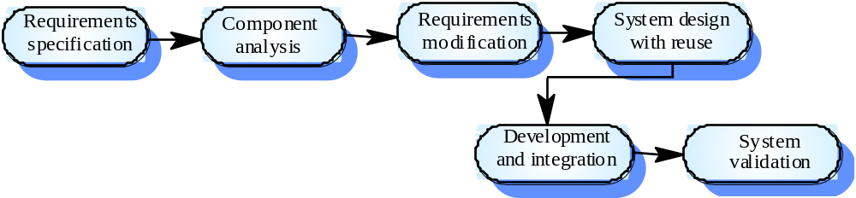
Reuse-oriented development

Slide 26
Process iteration
Modern development processes take iteration as fundamental, and try to provide ways of managing, rather than ignoring, the risk
System requirements ALWAYS evolve in the course of a project so process iteration where earlier stages are reworked is always part of the process for large systems
Iteration can be applied to any of the generic process models
Two (related) approaches
  Incremental development
  Spiral development

Slide 27
Incremental development
Rather than deliver the system in a single attempt, the development and delivery is broken down into increments with each increment delivering part of the required functionality
User requirements are prioritised and the highest priority requirements are included in early increments
Once the development of an increment is started, the requirements are frozen though requirements for later increments can continue to evolve

Slide 28
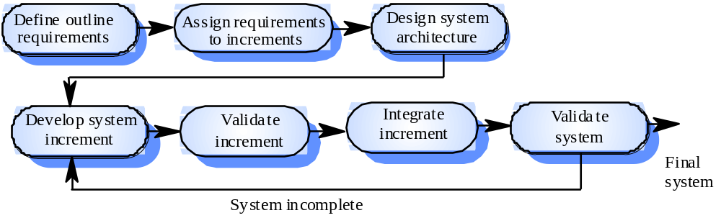
Incremental development

Slide 29
Incremental development advantages
Customer value can be delivered with each increment so system functionality is available earlier
Early increments act as a prototype to help elicit requirements for later increments
Lower risk of overall project failure
The highest priority system services tend to receive the most testing

Slide 30
Extreme programming
New approach to development based on the development and delivery of very small increments of functionality
Relies on constant code improvement, user involvement in the development team and pairwise programming
Design of the test suits first !
Then you perform testing of the system after each small increment

Slide 31
Spiral development
Process is represented as a spiral rather than as a sequence of activities with backtracking
Each loop in the spiral represents a phase in the process.
No fixed phases such as specification or design - loops in the spiral are chosen depending on what is required
Risks are explicitly assessed and resolved throughout the process

Slide 32
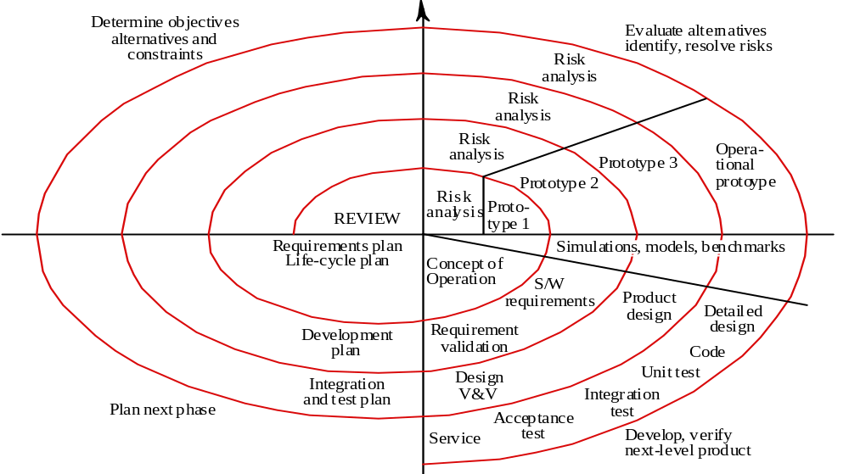
Spiral model of the software process

Slide 33
Spiral model sectors
Objective setting
  Specific objectives for the phase are identified
Risk assessment and reduction
  Risks are assessed and activities put in place to reduce the key risks
Development and validation
  A development model for the system is chosen which can be any of the generic models
Planning
  The project is reviewed and the next phase of the spiral is planned

